Slide 1
R&D for Ultimate Storage Rings
R. Hettel for the DLSR R&D study group
FLS 2012
JNAL
March 7, 2012

Slide 2
USR Features
• High coherent fraction
• “Round” beams
• Short bunches (~5-10 ps RMS from low momentum compaction factor)
• Special operating modes could include:
few-turn, sub-ps bunch mode
100-1000 turn mode with injection from superconducting linac operating without energy recovery (e.g. ~1 mA @ few GeV)
localized bunch compression systems in long straight sections
bunch tailoring with low alpha, non linear momentum compaction
lasing in an FEL located in a switched bypass
partial lasing at soft X-ray wavelengths using the stored beam
• “Long” lifetime: if the bunch dimensions are small enough Touschek lifetime increases (NSLS-II and MAX-IV may begin to see this effect)
• Damping wigglers to reduce emittance by ~x2
• On-axis injection (maybe) and “swap-out” injection for small dynamic aperture

Slide 3
Ultimate Storage Rings – Design and R&D
USRs in context with FELs
“Science and Technology of Future Light Sources – A White Paper”
ANL, BNL, LBNL, SLAC, Dec. 2008
International discussions:
BES workshop 2009
FLS2010
FLS 2012
DLSR R&D study group:
“R&D for Diffraction Limited Storage Rings – A White Paper” – DRAFT rev 2-22-12
ANL/APS: M. Borland, L. Emery, R. Gerig, D. Haeffner, A. Xiao
BNL/NSLS: F. Willeke, …
LBNL/ALS: D. Robin, C. Steier
SLAC/SSRL: K. Bane, Y. Cai, A. Chao, R. Hettel, X. Huang, C.-C. Kao, Y. Nosochkov, T. Rabedeau, J. Safranek, M-H Wang
More will join

Slide 5
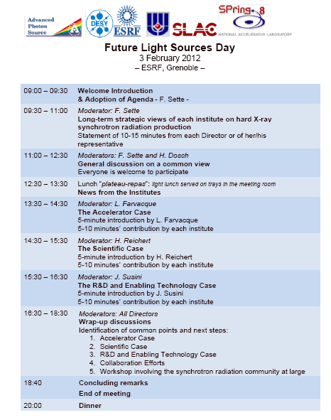

Slide 6
R&D for Diffraction Limited Storage Rings
Scientific applications:
Photon research applications that motivate the need for USRs and can guide their design parameters need to be identified.
Optimized ring parameters:
Once potential scientific applications are identified, requisite photon beam parameters, including brightness, flux, spectrum, coherence, bunch length, etc., can be specified. Following this, studies are required to optimize storage ring parameters and capabilities, including electron energy, circumference, emittance, insertion devices (IDs) and special operating modes, to meet science application goals and to maximize ring performance.
Lattice and geometry:
The choice of lattice cell types together with analyses of sensitivity to errors and associated beam dynamics are dependent on the emittance requirement, the number and lengths of straight sections for insertion devices and special components (e.g. long lasing IDs, bunch manipulation components, etc.), and the layout of photon beam lines and experimental halls.
Lattice geometries that consolidate ID straight sections in sub-sections of the total ring circumference, instead of distributing them evenly around the ring, could lead to reduced construction costs for beam line experimental halls for large circumference USRs - a cost-benefit trade-off with emittance.

Slide 7
R&D for Diffraction Limited Storage Rings – cont.
Dynamic acceptance:
The very strong focusing required for low emittance introduces large chromatic aberrations in the lattice that must be corrected using strong sextupoles and consequent resonance driving terms that reduce dynamic and momentum acceptance.
Longitudinal emittance/energy spread:
Can energy spread be reduced by cooling, beam manipulation, etc.?
Collective effects and lifetime:
Studies are required to develop accurate models for intrabeam scattering (IBS), ring impedances, coherent synchrotron radiation impedances, ion and electron cloud accumulation and their effects on beam dynamics, instabilities and lifetime and how to mitigate associated problems.
Round beams:
Studies are required to determine the best way to produce oval or round beams other than coupling resonance since that might impair injection or create difficulties in correcting the lattice.
Injection:
On-axis injection schemes, including the possible use of accumulator rings, should be investigated. Such schemes may require kickers having very fast rise- and fall-times and very flat-top waveforms and possibly accumulator rings that can also serve as booster synchrotrons for injection. Some aspects of on-axis injection can be tested in existing machines.

Slide 8
R&D for Diffraction Limited Storage Rings – cont.
Special operating modes:
More detailed study is needed to evaluate the possibilities of the short bunch, high peak current,tailored bunch, few-turn and lasing modes of operation.
Code development and benchmarking:
Computer codes are needed that provide integrated optimization of lattice and collective effects, that accurately represent the magnetic field interference in closely-spaced magnets, and that accurately simulate beam impedances for short bunches. Codes should be benchmarked with experiments on existing machines, perhaps operated in unusual modes that mimic aspects of USRs.
Accelerator systems and components:
The extremely low emittance and large circumference of USRs presents challenges for magnet and vacuum chamber design together with highly stable support systems, bunch lengthening/shortening and beam manipulation RF systems, advanced low level RF systems fast kickers and pulsers, precision electron orbit and photon beam trajectory feedback systems, multibunch feedback systems, and advanced beam diagnostics.
Value engineering:
Ways to maximize performance and minimize costs for large USR facilities are needed for all accelerator and beam line systems, as well as conventional facilities that include accelerator tunnel, beam line experimental halls, office buildings, temperature control systems and other utilities.

Slide 9
R&D for Diffraction Limited Storage Rings – cont.
Photon beam line systems and components:
Preserving the brightness, coherence and stability of very low emittance photon beams presents challenges to X-ray mirrors, monochromators and other optical components, similar in many ways to those encountered at FEL facilities. Improved mirror polish/figures would reduce emittance and coherence degradation. Advances in micro-focusing optics, such as smaller zone plate line widths, would enhance microscope resolution. High average beam power and power density necessitates development of improved optical cooling and thermal designs for these components. Improved thermal designs could reduce masking costs and provide more beam line layout flexibility. Beam stability would be enhanced using advanced beam position and shape monitors incorporated into feedback systems and with Improvements in optics support and experimental hall floor stability. Finally, developments in minimal optics and lensless imaging methods would maximize performance in some cases.
Insertion devices:
Enhancements in permanent magnet and superconducting magnet technology (Figure 4) would increase source brightness. Reducing undulator phase error would enhance performance for very high harmonics. High temperature superconducting technology, novel magnetic structures for unique applications, devices that minimize unused power on optics and vertically oriented undulators would all contribute to USR performance.

